Slide 1


NATURAL
BIOMATERIALS

Slide 2


TEAM MEMBERS:-
R.Vasavi -9922020037
P.Varshitha -9922020002
K.Manasa Shiva Sai -9922020013
K.Likitha -9922020025
P.Akshitha -9922020015

Slide 3
DEFINITON OF NATURAL BIOMATERIALS
Naturally Occurring :- Natural biomaterials are derived from sources found in nature, such as plants, animals, and microorganisms.
Biocompatible & Sustainable :- These materials have the ability to integrate with the body's tissues without causing adverse reactions. They are also environmentally friendly and have low environmental impact.

Slide 4
Structural & Functional :- Natural biomaterials can provide structural support and perform specific functions within the body, promoting healing and regeneration.
Wide Range of Properties :- These materials possess a diverse set of properties, including mechanical strength, flexibility, and biodegradability, making them suitable for different clinical applications.

Slide 5

EXAMPLES OF BIOMATERIALS:-
1) Silk
An elegant and versatile material, silk has been used for centuries in medicine forwound healing, drug delivery, tissue engineering, and more.

Slide 6
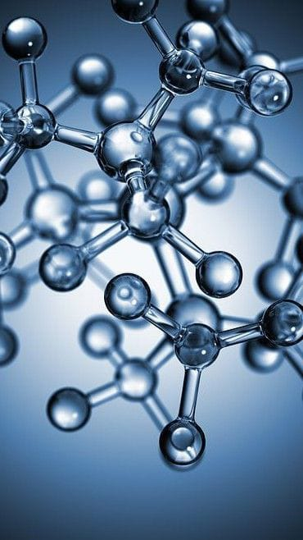
2) Collagen
The most abundant protein in the human body, collagen is widely used in medical applications due to its biocompatibility and ability to support tissue regeneration.

Slide 7
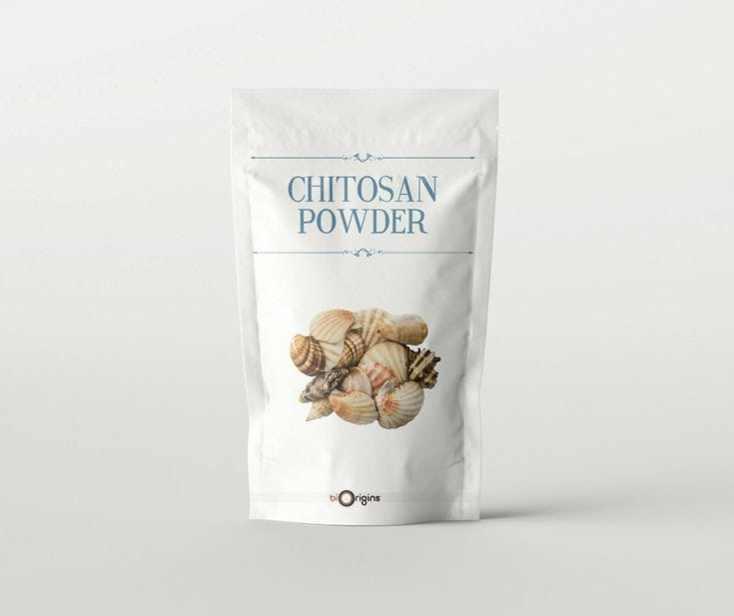
3)Chitosan
A natural polymer derived from crustacean shells, chitosan exhibits antimicrobial properties and is used in wound dressings, drug delivery systems, and tissue engineering.

Slide 8

4)Alginate
Obtained from brown seaweeds, alginate is a biocompatible and biodegradable material commonly used in cell encapsulation , tissue engineering, and drug delivery systems.

Slide 9
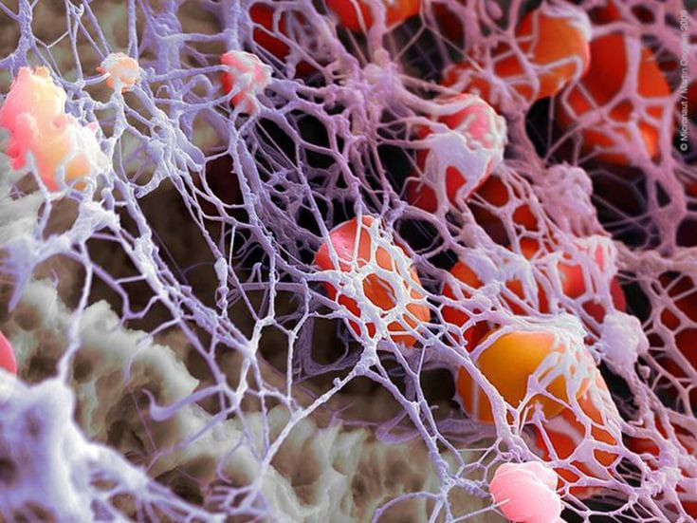
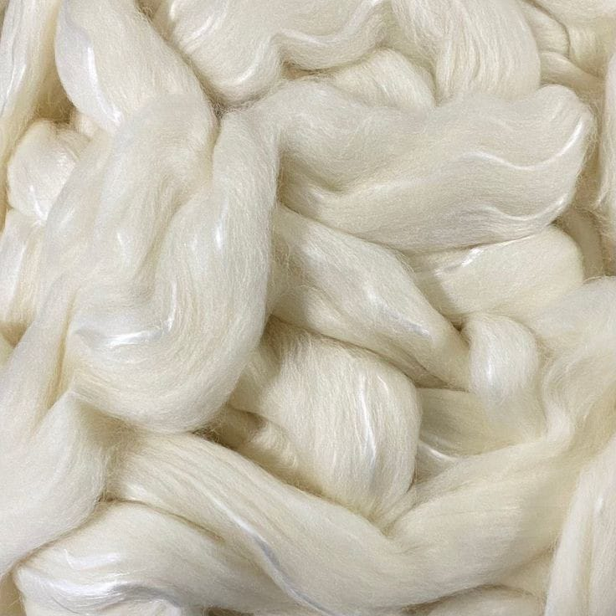
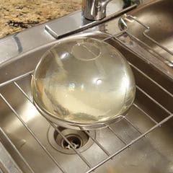
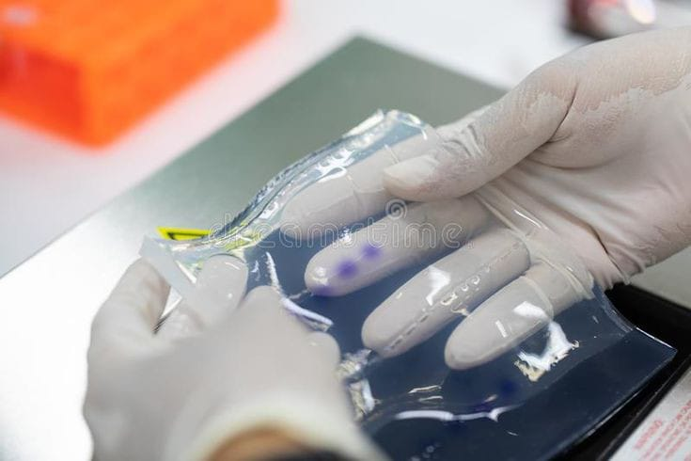
Few more examples of Natural Biomaterials:-
GELATIN
AGAROSE
FIBRIN
CELLULOSE

Slide 10
PROPERTIES
Biocompatibility
Biodegradability
Variable Mechanical Strength
Flexibility

Slide 11
Applications of Natural Biomaterials in Medicine :-
Tissue Engineering :-Natural biomaterial scaffolds are used to promote tissue regeneration and repair damaged organs.
Drug Delivery Systems :- Natural biomaterial carriers transport drugs to target sites and control their release for enhanced therapeutic outcomes.
Wound Healing :-Dressings made from natural biomaterials help create a conducive environment for wound healing and accelerate the process.

Slide 12
Challenges and Limitations of Natural Biomaterials :-
Availability and Sourcing :- Collecting and processing natural biomaterials can be time-consuming and expensive.
Batch-to-Batch Variability :- Due to natural variations , the properties of these materials may differ between batches, requiring careful quality control.
Immune Responses :- Although biocompatible, natural biomaterials may still trigger immune responses in some individuals.

Slide 13
Emerging Trends and Innovations in Natural Biomaterials:-
Nanotechnology :- Advancements in nanotechnology enable the development of nanostructured natural biomaterials with enhanced properties and functionalities.
Bioactive Molecules :- Incorporating bioactive molecules into natural biomaterials can improve their performance and enable targeted therapeutic interventions.
3D Bioprinting :- Using 3D bioprinting techniques, researchers are fabricating intricate structures using natural biomaterials, paving the way for complex tissue engineering

Slide 14
Conclusion:-
Natural biomaterials offer unique advantages such as biocompatibility, biodegradability, and diverse properties, making them valuable for various medical applications. However, challenges in sourcing, variability, and immune responses need to be addressed to harness their full potential. Exciting advancements in nanotechnology, bioactive molecules, and 3D bioprinting are propelling the field forward, opening up new possibilities for regenerative medicine and personalized healthcare.

